Slide 1


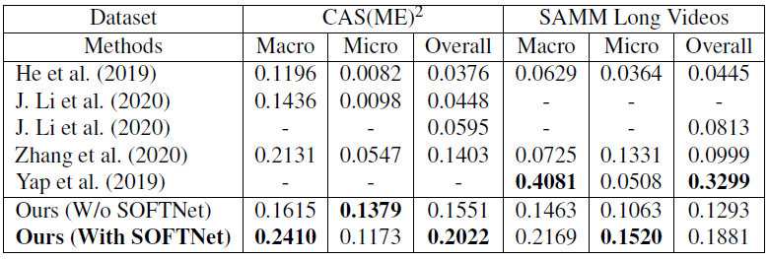
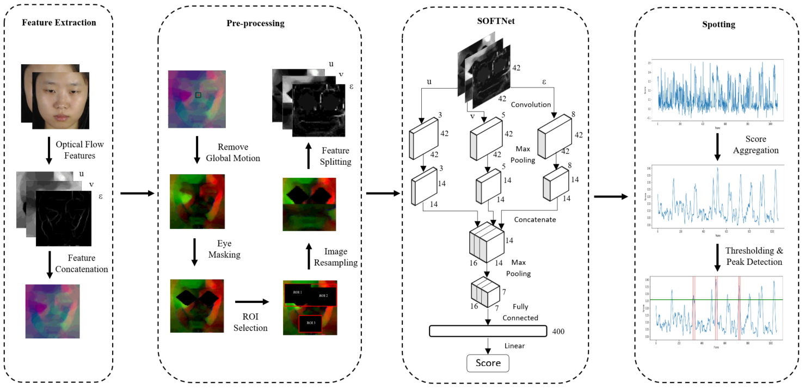
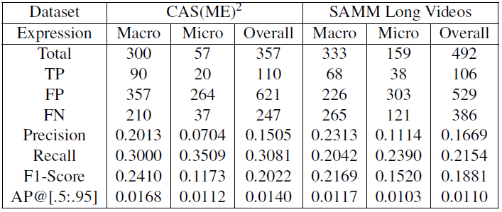
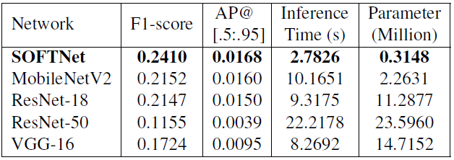
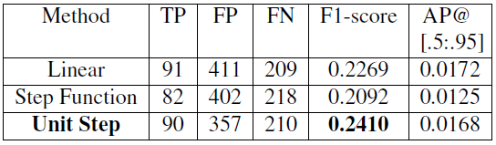
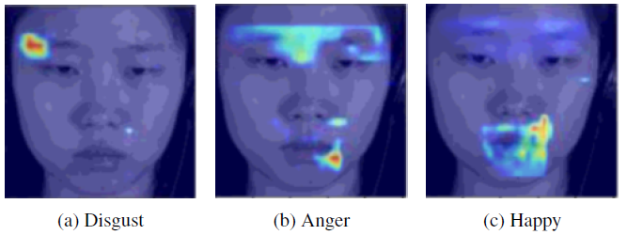
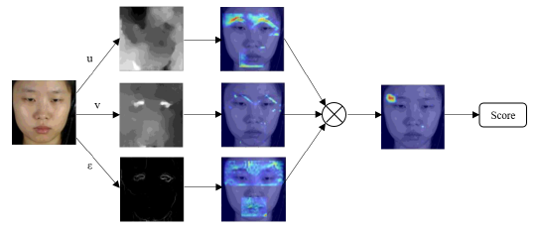
1661: Detecting Micro-Expression Occurrences in Videos
Results and Discussions
Liong Gen Bing 1161104505
Supervisor: Dr. John See Su Yang Moderator: Dr. Wong Lai Kuan
Comparison between proposed approach against MEGC 2020
Our approach (With SOFTNet) outperforms other methods on CAS(ME)² while ranked-second on SAMM Long Videos, behind the original dataset authors.
Detail result of proposed SOFTNet approach
The amount of TP that we obtained is comparable with other approaches whilst with a much lower FP.
Performance comparison on CAS(ME)² macro-expression
SOFTNet model shows the superiority across various aspects from accuracy to efficiency.
In pseudo-labeling, unit step outperforms the other functions.
Class Activation Maps
Conclusion
We propose a new regression-based strategy towards macro- and micro-expression spotting in long videos and achieved promising results on MEGC 2020 benchmark. We re-introduce the AP@[.5:.95] metric for a more consistent measure across expressions.
Abstract
Research Methodology
Micro-expression is subtle and occurs when a person intends to conceal or suppress their inner feeling in high-stake situations. To spot the occurrences, Shallow Optical Flow Three-stream CNN (SOFTNet) model is proposed to predict a score that captures the likelihood of a frame being in an expression interval. By fashioning the spotting task as a regression problem, unit step function is introduced to pseudo-label the frames in the learning process. We demonstrate the efficacy and efficiency of the proposed approach on the recent MEGC 2020 benchmark, where state-of-the-art performance is achieved on CAS(ME)² with equally promising results on SAMM Long Videos.
Proposed Approach
Feature Extraction - Extract the optical flow features (u, v, ε) that represents each frame.
Pre-processing - Remove global head motion, eye masking, ROI selection, and image resampling.
SOFTNet - Three-stream shallow architecture that takes inputs (u, v, ε) and outputs a spotting confidence score.
Spotting - Smoothing spotting confidence score, then perform thresholding and peak detection.
Dataset
CAS(ME)² – Contains 98 long videos with 300 macro and 57 micro-expressions from 22 subjects.
SAMM Long Videos – Contains 147 long videos with 343 macro and 159 micro-expressions from 32 subjects. Most culturally diverse datasets in this domain.
Evaluation
Leave-One-Subject-Out (LOSO)
cross-validation
F1-Score (MEGC 2020)
AP@[.5:.95] (Proposed)
Objectives
To design and develop a robust approach for spotting facial micro- and macro-expression occurrences from the long videos.
To understand the limitation of methodologies in literature and adopt the suitable techniques with some improvements.
To investigate the viable metric of measuring the efficacy of locating facial expression occurrences and validate the proposed approach.
Literature Review
Pre-processing
Eye Masking (Liong et al., 2016)
ROI Selection (Liong et al., 2015, 2016), (J, Li et al., 2018)
Spotting
LBP-χ² (Moilanen et al., 2014)
LTP-ML (J, Li et al., 2018)
MDMD (He et al., 2019)
Contribution
We propose a multi-stream shallow network infused with optical flow inputs to regress a score for spotting.
We present a new automatic way of pseudo-labeling frames to enable the training of a regression model.
We demonstrate the efficacy of the proposed approach with few extensive experiments.
We re-explore the viability of a spotting metric to provide a fairer and more consistent measure for locating both macro- and micro-expression occurrences.
SOFTNet is able to learn from facial regions that correspond to the Action Unit triggered.
Notes:
Empty Template

Slide 2
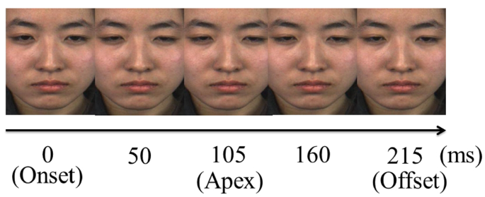
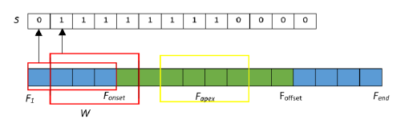
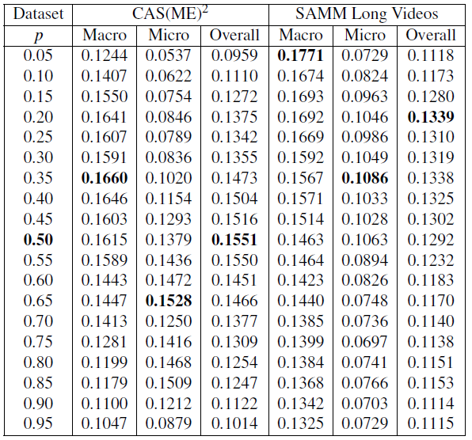
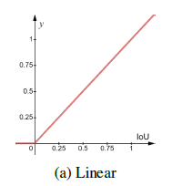
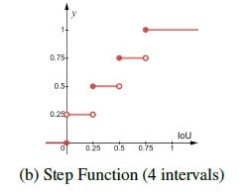
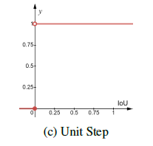
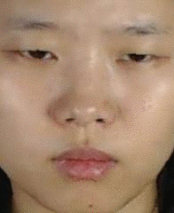
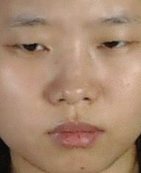
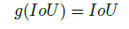
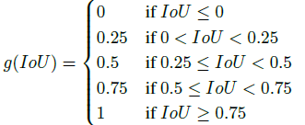
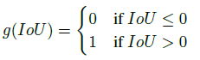
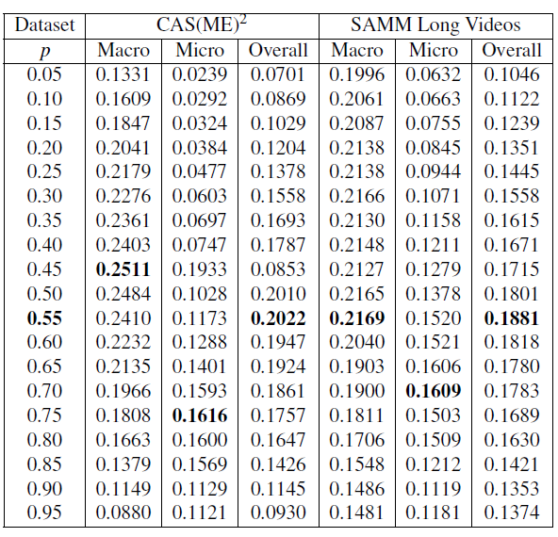
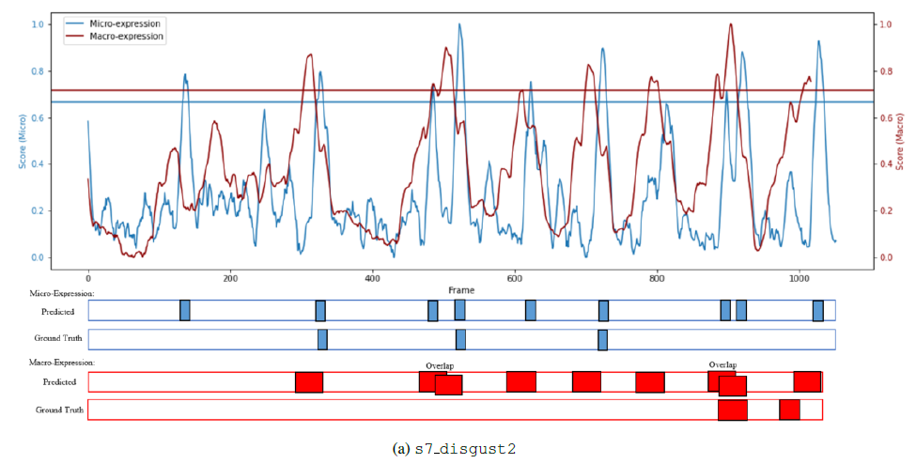

Supplementary
Micro-Expression Frames
Pseudo-labeling
Parameter Selection
Results in terms of F1-Score
Without SOFTNet
Example of Expression
Micro-Expression
Macro-Expression
0.3s
1.73s
Visualization
With SOFTNet
Example of when a person is lying

Slide 3
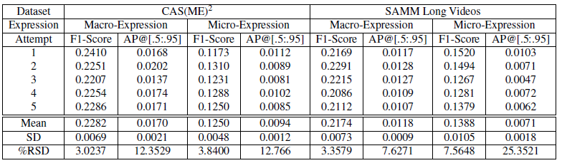
Supplementary
Result for 5 attempts

